Slide 1
4
Chapter
Foundations
of Planning
Copyright ©2011 Pearson Education

Slide 2
How Do Managers Set Goals and Develop Plans?
Goals (objectives)
  Desired outcomes or targets
Stated (Real) Goals
  Official statements of what an organization says, and wants its stakeholders to believe, its goals are.
Plans
  Documents that outline how goals will be met,
  include resource allocations, schedules, budgets, and other actions to achieve the goals.

Slide 3
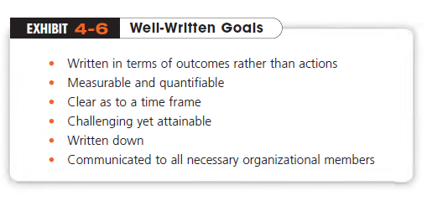

Slide 4
What Is Planning?
Planning is often called the primary management function because it establishes the basis for all the other things managers do
Planning encompasses establishing
  the organization’s objectives or goals,
  an overall strategy for achieving those goals,
  a comprehensive hierarchy of plans to integrate and coordinate activities.

Slide 5
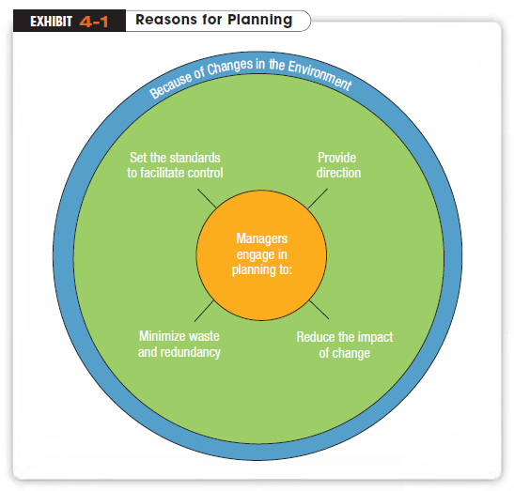

Slide 6
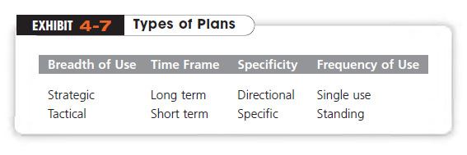
Types of Plans
The most popular ways to describe plans are in terms of their type:

Slide 7
Breadth
Strategic Plans
  Plans that apply to the entire organization and encompass the organization’s overall goals.
Tactical Plans (sometimes referred to as operational plans)
  Plans that specify the details of how the overall goals are to be .achieved
Copyright ©2011 Pearson Education

Slide 8
Time Frame
Long-term Plans
  Plans with a time frame beyond three years
Short-term Plans
  Plans with a time frame of one year or less

Slide 9
Specificity
Specific Plans
  Plans that are clearly defined and leave no room for interpretation
Directional Plans
  Plans that are flexible and set general guidelines
  Intuitively, it would seem that specific plans would be preferable to directional, or loosely guided, plans. However, when uncertainty is high and managers must be flexible in order to respond to unexpected changes, they’d likely use directional plans.

Slide 10
Plans by Frequency of Use
Single-use Plan
  A one-time plan specifically designed to meet the needs of a unique situation
Standing Plans
  Plans that are ongoing and provide guidance for activities performed repeatedly
  Commitment Concept: plans should extend far enough to meet those commitments made when the plans were developed

Slide 11
The Traditional Approach to Planning
In the traditional approach planning is done by top management
Formal Planning Department
  A group of planning specialists whose sole responsibility is to help write the various organizational plans
  plans developed by top level managers flow down through other organizational levels

Slide 12
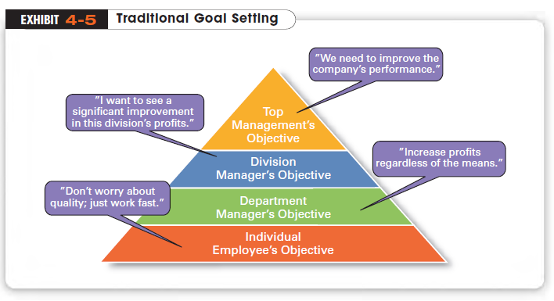

Slide 13
Traditional Goal Setting
  Goals set by top managers flow down through the organization and become sub-goals for each organizational area
  However, stated goals are often conflicting and influenced by what various stakeholders think organizations should do.

Slide 14
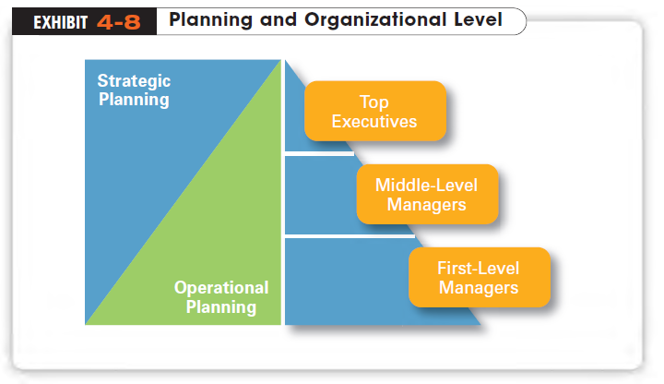

Slide 15
What Do Managers Need to Know About Strategic Management?
Strategies
  Plans for how the organization will do what it’s in business to do, how it will compete successfully, and how it will attract its customers in order to achieve its goals.
Strategic Management
  What managers do to develop an organization’s strategies.

Slide 16
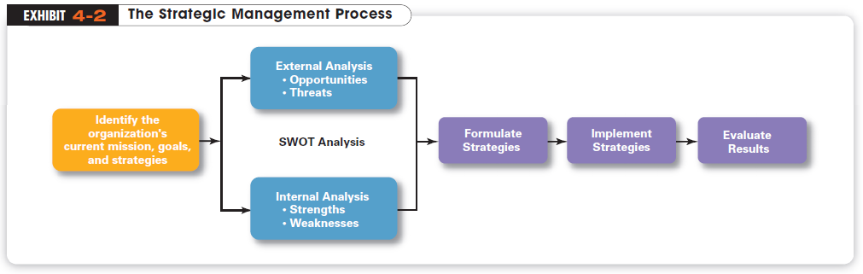
The strategic management is a six-step process that encompasses strategy planning, implementation, and evaluation.

Slide 17
What is a SWOT Analysis?
SWOT Analysis
  The combined external and internal analyses
Strengths
  Any activities the organization does well or any unique resources that it has
Weaknesses
  Activities the organization doesn’t do well or resources it needs but doesn’t possess

Slide 18
SWOT Analysis (cont.)
Opportunities
  Positive trends in the external environment
Threats
  Negative trends in the external environment
  After completing the SWOT, managers are ready to formulate appropriate strategies (1) to exploit an organization’s strengths and external opportunities,
  (2) buffer or protect the organization from external threats, or
  (3) correct critical weaknesses

Slide 19
The Strategic Management Process
STEP 1: Identifying the organization’s current mission, goals and strategies
STEP 2: Doing an external analysis
STEP 3: Doing an internal analysis
STEP 4: Formulating the strategies
STEP 5: Implementing strategies
STEP 6: Evaluating results
The first four steps describe the planning that must take place, but implementation and evaluation are just as important!
Even the best strategies can fail if management doesn’t implement or evaluate them properly.

Slide 20
Strategic Management Process (cont.)
Mission
  A statement of an organization’s purpose
  Defining the mission forces managers to identify what it’s in business to do.
    Avon’s mission “To be the company that best understands and satisfies the product, service, and self-fulfillment needs of women on a global level.”
    Facebook’s mission “a social utility that connects you with the people around you.”

Slide 21
Capabilities
  An organization’s skills and abilities in doing the work activities needed in its business
Core Competencies
  The major value-creating capabilities of an organization.

Slide 22
Mission Statement of the Department of Tourism Administration
To generate knowledge on tourism adminstration and related fields and to educate individuals who will excel in the practice and contribute to the development of tourism at the national and international level.
In order to achieve this mission, the Department, reflecting the scientific excellence of Boğaziçi University and adhering to the highest ethical standards, undertakes research and quality education programs.
In line with these goals, the Department aims to bring together the very best academicians, experts and students in a rewarding environment.

Slide 23
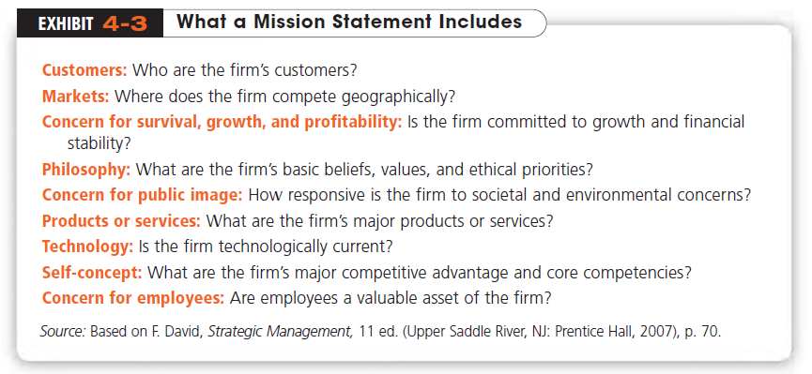

Slide 24
What Are Various Types of Strategies?
Corporate Strategy
  An organizational strategy that specifies what businesses a company is in or wants to be in and what it wants to do with those businesses
  It’s based on the mission and goals of the organization and the roles that each business unit of the organization will play
  The three main types of corporate strategies are growth, stability, and renewal

Slide 25
Growth Strategy
A corporate strategy in which an organization expands the number of markets served or products offered either through its current business or through new business(es).
  Because of its growth strategy, an organization may increase revenues, number of employees, or market share.
Some growth strategies include
  Concentration (focusing on primary line of business)
  Horizontal Integration (e.g., acquiring competitors)
  Vertical Integration (becoming own supplier or distributor)
  Diversification (combining with other companies)

Slide 26
Turkish Airline’s reaction to market deregulation
In 2003, Turkish Airlines has decided to grow its fleet whilst keeping the other resources stable excluding the cabin and crew. It achieved to keep its costs and quality stable while improving productivity.
As a strategic response to low-cost carriers, launched Anadolu Jet, a low-cost sub-brand of Turkish Airlines. Although Turkish Airlines kept its position on the cost/quality image.
Additionally, Turkish Airlines decided to vertically de-integrate its ground operations such as handling and catering. This move led to achieving economies of scale and the ability to focus on its operations and outsource service for lower costs.
A Study of The Strategic Responses of Turkish Airline Companies to the Deregulation in Turkey, Journal of Management Research (2013)

Slide 27
Other Corporate Strategies
Stability Strategy
  A corporate strategy in which an organization continues to do what it is currently doing and achieve the value chain efficiency.
Renewal Strategy
  A corporate strategy that addresses declining organizational performance
    A retrenchment strategy is a short-run renewal strategy used for minor performance problems
    A turnaround strategy used when the problems are more serious and drastic intervention is needed.

Slide 28
Competitive Strategy
An organizational strategy for how an organization will compete in its business(es)
Competitive Advantage
  What sets an organization apart; its distinctive edge
Strategic Business units (SBUs)
  An organization’s single businesses that are independent and formulate their own competitive strategy

Slide 29
Types of Competitive Strategies
Managers must choose a competitive strategy that will give it a distinct advantage by capitalizing on the strengths of the organization and the industry it is in.
  Cost Leadership Strategy: on the basis of having the lowest costs in the industry
  Differentiation Strategy: on the basis of having unique products that are valued by customers
  Focus Strategy: in a narrow segment or niche with either a cost focus or a differentiation focus

Slide 30
Functional Strategy
The final type of strategies managers use are
Functional Strategies
  The strategies used in an organization’s various functional departments to support the competitive strategy

Slide 31
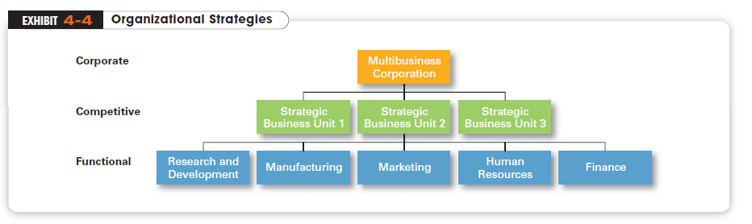

Slide 32
Critics have challenged some of the basic assumptions of planning
  Planning may create rigidity; flexibility is the key for dealing with market conditions.
  Formal plans can’t replace intuition and creativity.
  Planning focuses managers’ attention on today’s competition, not on tomorrow’s survival.
  Formal planning reinforces success, which may eventually lead to failure.

Slide 33
Quality as a Strategic Weapon
Many organizations are employing quality practices to build competitive advantage and attract and hold a loyal customer base
Benchmarking
  The basic idea of benchmarking is that managers can improve quality by analyzing and then copying the best practices of the leaders in various fields

Slide 34
How Can Managers Use Environmental Scanning?
Environmental Scanning
  An analysis of the external environment that involves screening large amounts of information to detect emerging trends
  Competitive Intelligence: One of the fastest-growing forms of environmental scanning that gives managers accurate information about competitors
  allows managers to anticipate competitors’ actions rather than merely react to them

Slide 35
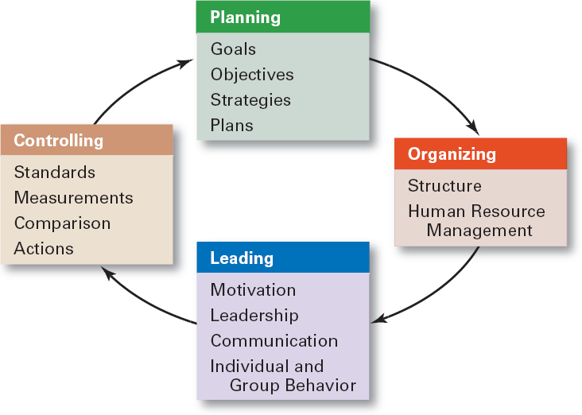
The Planning–Controlling Link

